Slide 1
EES203: Geochemistry
Instructor: Anoop Ambili
Email id: anoop@iisermohali.ac.in

Slide 2
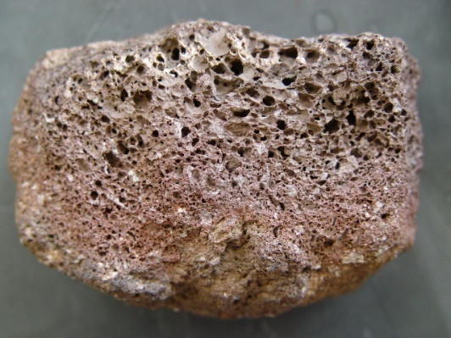
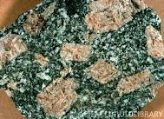
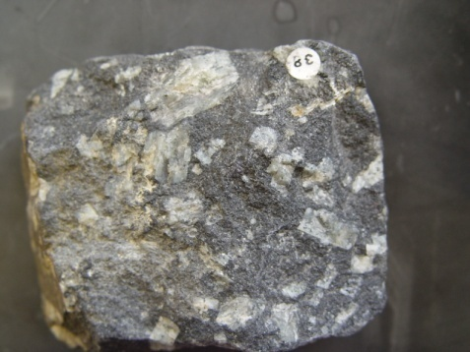
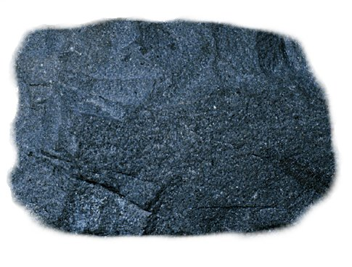
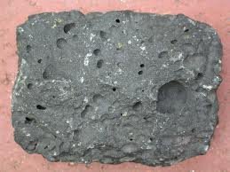
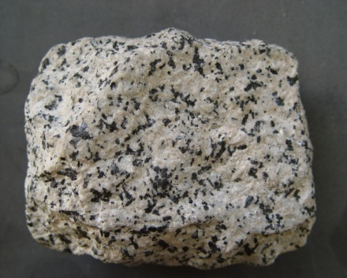
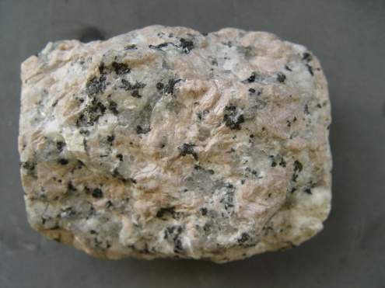
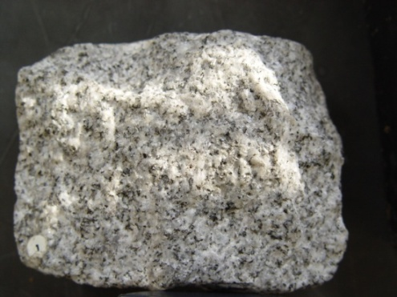
Why do we get so much variation in igneous rocks?
There is only Two or Three Types of Primary Magmas and Igneous rocks are formed due to cooling and solidification of magma. In principle, there should be two types of igneous rocks.
Over 700 types of igneous rocks are found.

Slide 3
A primary magma: Is the "first melt" produced by partial melting within the mantle, and which has not yet undergone any differentiation.
A primary magma may therefore evolve into a parental magma by differentiation.
A parental magma: Is a magma capable of producing all rocks belonging to an igneous rock series by differentiation.

Slide 4
Magmatic Differentiation - Definition
Magmatic differentiation is process through which a single homogeneous magma is able to produce two or more fractions (daughter magmas) of different composition, which ultimately forms diverse rock types.
The primary cause of change in the composition of a magma is cooling. Cooling causes the magma to begin to crystallize minerals from the melt or liquid portion of the magma.
Contamination is another cause of magma differentiation. Contamination can be caused by assimilation of wall rocks or mixing of two or more magmas.

Slide 5
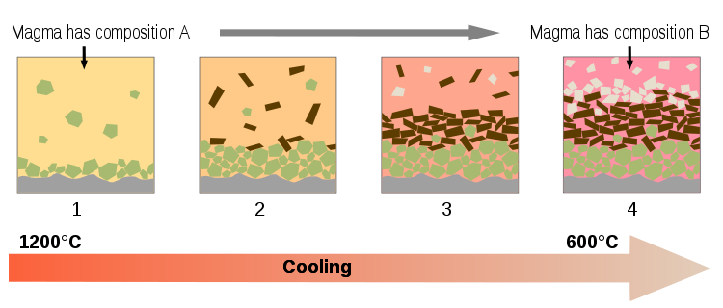

Slide 6
Mechanism of Differentiation
Three potential mechanism of differentiation are suggested:
Fractional Crystallization
Liquid Immiscibility
Assimilation

Slide 7
Fractional Crystallization
Most powerful mechanism of magmatic differentiation.
Fractional crystallization is the segregation and removal of crystallized minerals from a melt, which changes the composition of the melt.

Slide 8
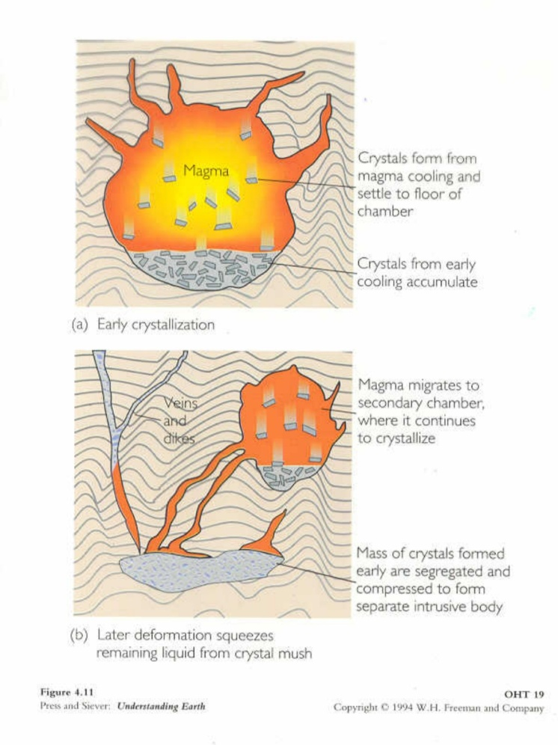
The process of Fractional Crystallization involves the separation and preservation of early-forming minerals, usually due to density differences.
Figure A show CRYSTAL SETTLING (a form of FRACTIONAL CRYSTALLIZATION.)
Figure B show MAGMA MIGRATION (another form of FRACTIONAL CRYSTALLIZATION.)

Slide 9
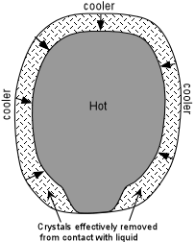

Slide 10
Gravity plays a very important role in settling of early formed crystals from the melt.
Parting between crystals and melt within a magmatic body may also be observed in flowing magma (documented in many dykes and sills), where greater concentration of large sized crystals commonly occur at the core (inner part) of dyke or sill (slow cooling at inner region so crystal grow in large size). This is known as Flowage Segregation.
Tectonic movements and some time the “Filter Pressing”- this mechanism has been proposed as a way to separate a liquid from a crystal-liquid mush.

Slide 11
Bowen’s Reaction Series
The process of magmatic differentiation by Crystal – Liquid Fractionation (Fractional Crystallization) is also explained by N.L. Bowen (1928). This process is popularly known as Bowen’ Reaction Series or Bowen’s Reaction Principle.
Bowens reaction series is a series of crystallization sequences that occur during magmatic cooling.
Bowen suggested a mechanism through which a magma may solidify as a single rock type or may give rise to many rock types.

Slide 12
According to Bowen’s Reaction Principle “ As crystallization of magma starts, there is a tendency for equilibrium to be maintained between solid (crystals) and liquid (residual melt) phases. To maintain this equilibrium, the early formed crystals (unless removed from the melt) react with the residual melt and change in composition (formation of new mineral) takes place”.
Bowen’ Reaction Principle illustrates how a primary basaltic magma may give rise granite or other igneous rocks (depending upon the degree of crystallization and reaction of early formed crystals with melt or removal of these crystals from the melt.

Slide 13
In Bowen’s Reaction Series there are two parallel series. One for Fe-Mg minerals and the other represents Plagioclage felspar group.
Both these series converge and merge into a single series.
The reaction series of Fe-Mg minerals is called as Discontinuous Series and that of Plagioclase is called as Continuous Series.

Slide 14
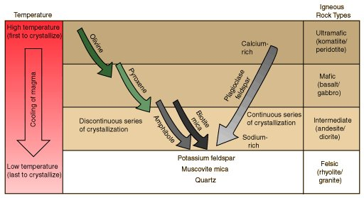

Slide 15
Discontinuous Series: At lowering of temperature (cooling starts), first mineral to crystallized is “Olivine”. As soon as it formed (unless it removed from the melt), with falling temperature the “Olivine” react with the melt and convert into “Mg-Pyroxene”. This will continue till whole “Olivine” get convert into “Mg-Pyroxenes”.
Later on the reaction remain continue and “Mg-Pyroxene” (unless removed from the melt), react with the melt and convert into “Ca-Pyroxene” and then “Hornblende”, then “Biotite”, with the falling temperature.

Slide 16
Continuous Series: At lowering of temperature (cooling starts), first plagioclase to crystallized is rich in Ca (Ca-Plagioclase). As the reaction goes on and temperature drops, the crystals become more and more sodic (unless remove from the melt).
The Potash Felspar and Muscovite are formed at later stages and the last formed mineral is “Quartz”.
Thus a basaltic magma on gradual cooling may convert into granitic melt (Quartz + K-Felspar + Muscovite), if the crystallized minerals do not removed from the melt. If removed in between the reaction then other rocks of that particular composition will form (at which stage the minerals removed).

Slide 17
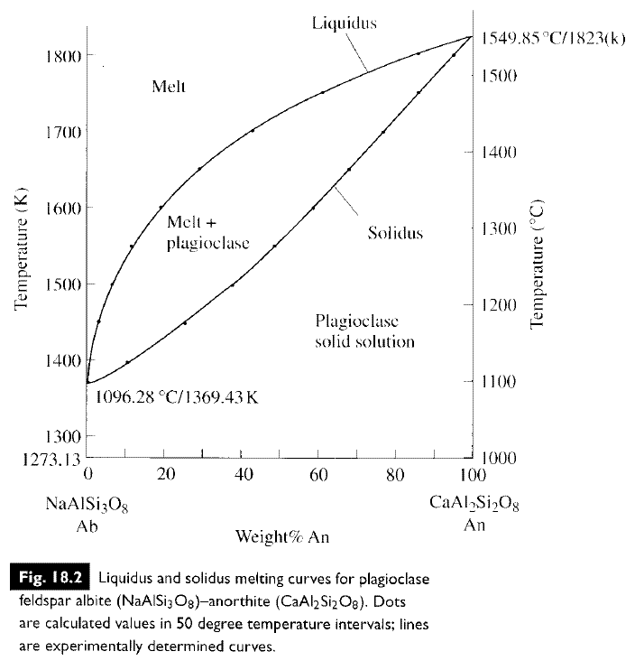
Solid solution series

Slide 18
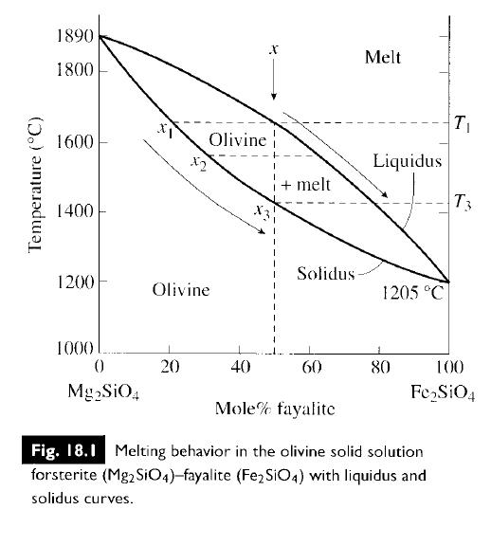
Solid solution series

Slide 19
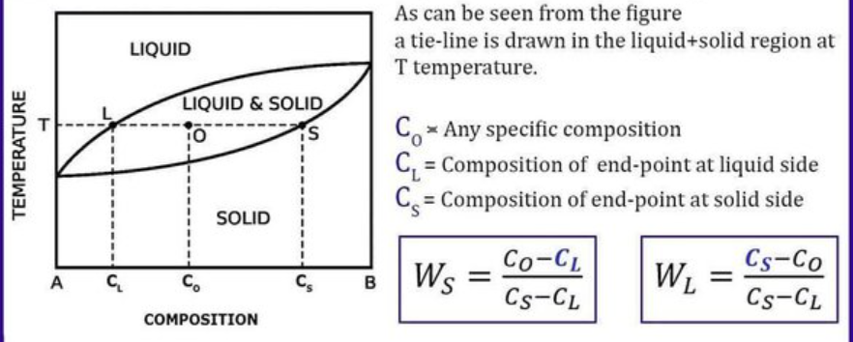
Lever rule

Slide 20
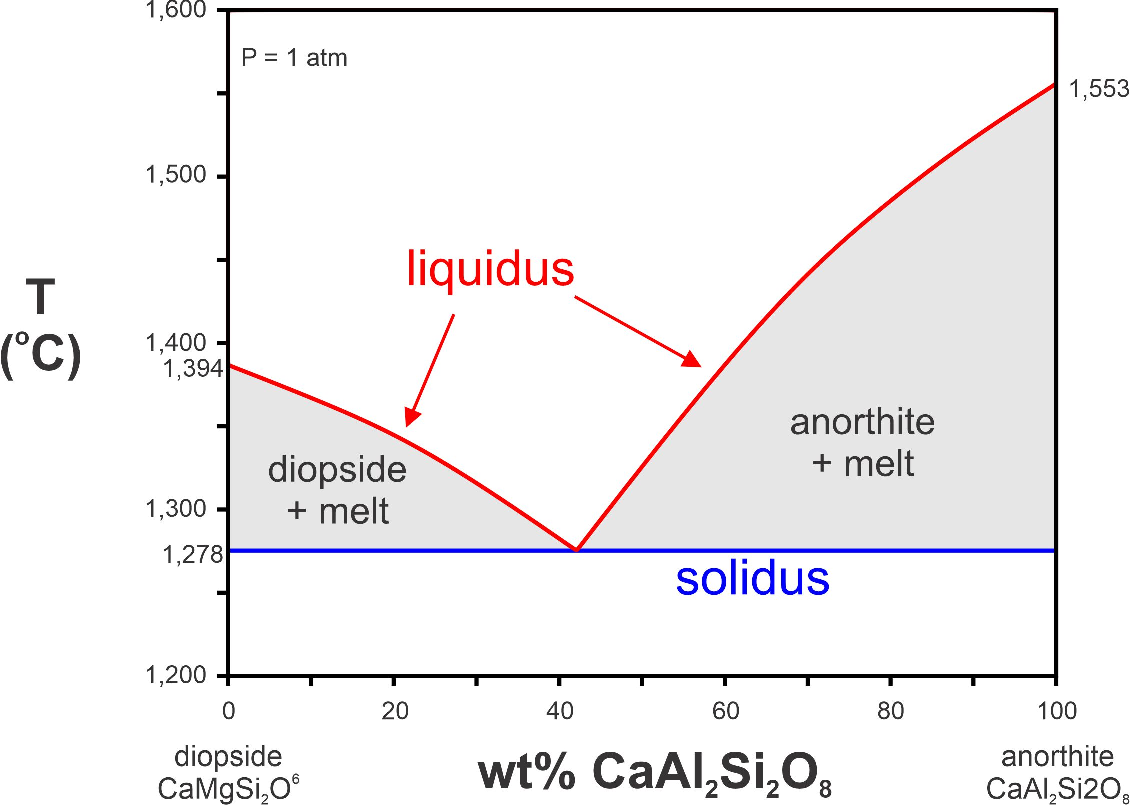
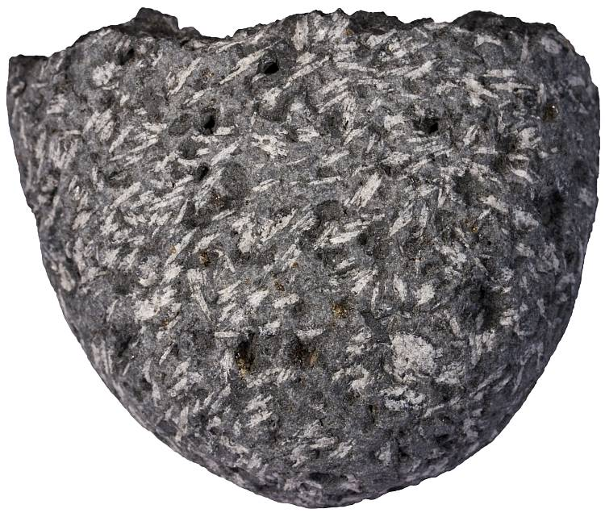
Binary eutectic system

Slide 21
Liquid Immiscibility
Laboratory experiments have shown that the Liquid Immiscibility also play an important role in magmatic differentiation and diversification of igneous rocks.
It is believed that a homogenous liquid magma on cooling, split into two immiscible liquid fractions (having different composition).
For e.g. a Tholeiitic liquid magma on cooling may split into two fractions (a) Granitic melt (b) Fe-Mg rich melt.

Slide 22
Tholeiitic Magma
Cooling
Granitic Melt
Fe-Mg rich Melt
Likewise, from mafic silicate magmas, Sulfide liquids may separate as immiscible fraction.
Similarly, highly alkaline magmas rich in CO₂ may separate into two liquids, one rich in carbonate, and the other rich in silica and alkalies. This process may be responsible for forming the rare carbonatite magmas. Carbonatites (alkaline igneous rocks) are commonly generated through the process of liquid immiscibility.

Slide 23
Assimilation
Assimilation is another process of responsible for diversification of igneous rock types.
Assimilation is the incorporation of matter from wall rocks into the magma to give a contaminated or hybrid magma.
During the intrusion of magma in wall rocks, some of the fraction of wall rock mixed in the magma and may become partially or completely melted (due to heat of magma) and merged into the liquid fraction of magma (causing change of composition of primary magma).

Slide 24
According to the Bowen (1928), a considerable amount of heat is necessary to melt the minerals of country rocks.
For the process of assimilation, magmatic temperature should be high otherwise only those minerals of wall rock will melt, which are having lower melting temperature. Wholesale (Bulk) assimilation by a liquid magma requires a superheated magma (very high temperature).
How do we know of assimilation?

Slide 25
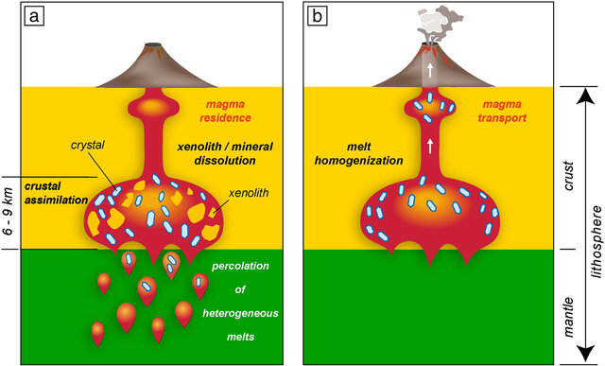

Slide 26
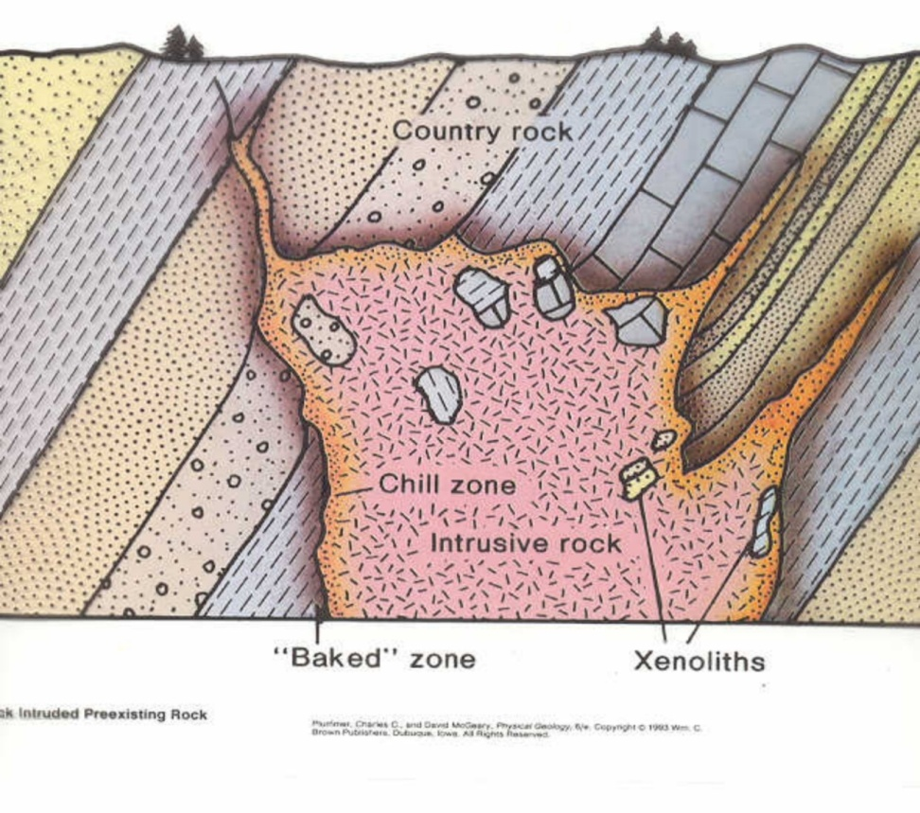
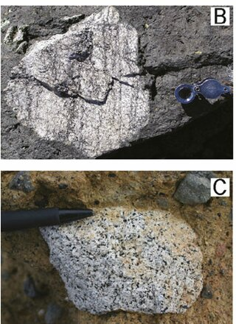

Slide 27
Magma Mixing
The process of magma mixing is also responsible for variation in igneous rocks.
Bunsen (1851) first suggested that the mixing of two contrast primary magmas (basaltic and rhyolitic) may account for the range of variation in the lava. Later on Durocher (1909) explained that all igneous rocks are derived from two primary magma only.
Magma mixing do occur in nature but petrologists do not consider it as the principal factor in magmatic evolution.

Slide 28
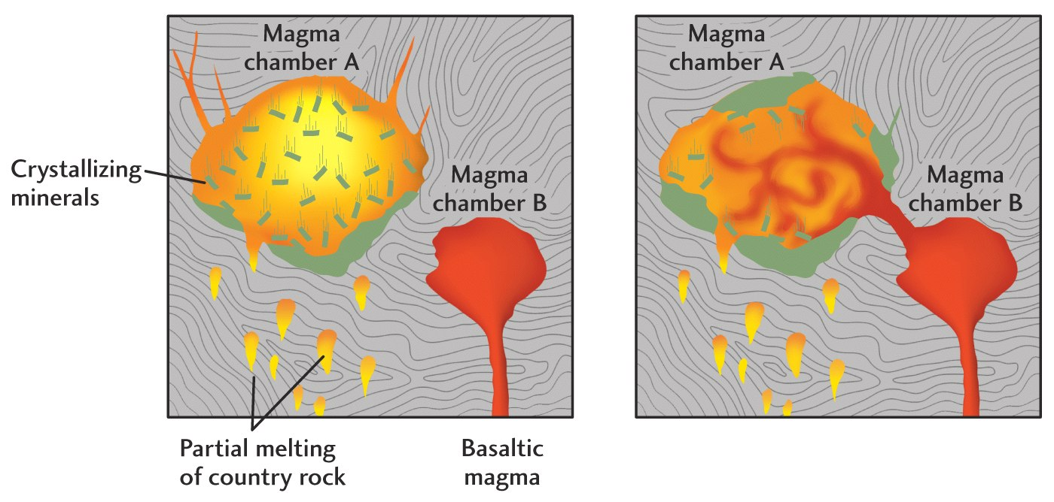
The magma mixing may be partial or complete. In partial mixing, the separate body or xenolith on one magma type is found in another. If it mixed completely, then it form a magma of different composition (hybrid magma).

Slide 29
magma mixing into two separate physico/chemical processes:
(i) mechanical mixing (also referred to as “magma mingling”), by which two or more batches of magma mingle without chemical exchanges between them,
(ii) a chemical mixing (also referred to as “magma mixing”) triggered by chemical exchanges between the interacting magmas in which elements move from one magma to the other according to compositional gradients continuously generated by the mechanical dispersion of the two magmas

Slide 30
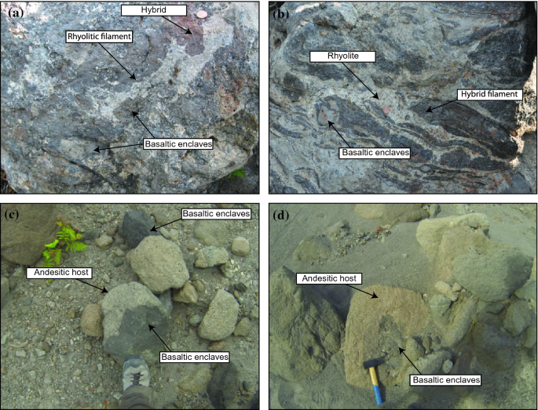

Slide 31
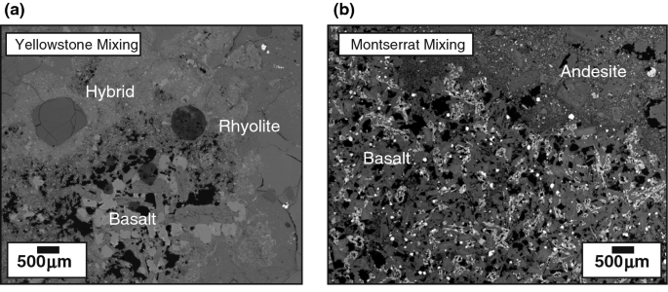
Source: Morgavi et al., 2017
Magma Mixing

Slide 32
Elemental partioning during magmatic differentiation

Slide 33
GOLDSCHMIDT’S RULES
1. The ions of one element can extensively replace those of another in ionic crystals if their radii differ by less than approximately 15%.
2. Ions whose charges differ by one unit substitute readily for one another provided electrical neutrality of the crystal is maintained. If the charges differ by more than one unit, substitution is generally slight.
3. When two different ions can occupy a particular position in a crystal lattice, the ion with the higher ionic potential forms a stronger bond with the anions surrounding the site.
Source: Faure, Chapter-8

Slide 34
RINGWOOD’S MODIFICATION OF GOLDSCHMIDT’S RULES
4. Substitutions may be limited, even when the size and charge criteria are satisfied, when the competing ions have different electronegativities and form bonds of different ionic character.
This rule was proposed in 1955 to explain discrepancies with respect to the first three Goldschmidt rules.
For example, Na⁺ and Cu⁺ have the same radius and charge, but do not substitute for one another.
Source: Faure, Chapter-8

Slide 35
Coupled Substitution
When the ion of a major element in a mineral is replaced with something having a different charge, the charge imbalance created must be neutralized by addition of a counter ion
Example → addition of Al³⁺ in a silicate structure (replacing Si⁴⁺) requires addition of a Na⁺ or K⁺ (Key to understanding feldspar chemistry…). When 2 Al³⁺ are added for Si⁴⁺, this then can be balanced by adding a Ca²⁺ ion
Source: Faure, Chapter-8

Slide 36
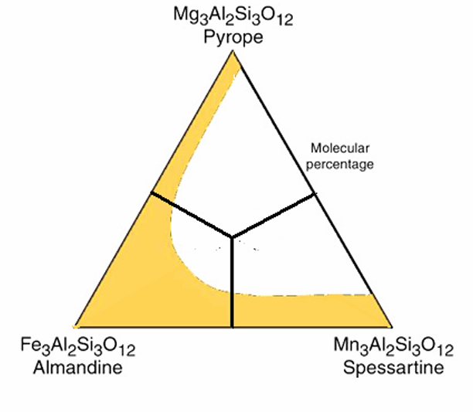
SOLID SOLUTION
Occurs when, in a crystalline solid, one element substitutes for another..
The garnet is a solid solution of the following end member components:
Pyrope - Mg₃Al₂Si₃O₁₂; Spessartine - Mn₃Al₂Si₃O₁₂;
Almandine - Fe₃Al₂Si₃O₁₂.

Slide 37
Trace elements (Camouflage)
Occurs when the minor element has the same charge and similar ionic radius as the major element (same ionic potential; no preference).
Zr⁴⁺ (0.80 Å); Hf⁴⁺ (0.79 Å)
Hf usually does not form its own mineral; it is camouflaged in zircon
Source: Faure, Chapter-8

Slide 38
CAPTURE
Occurs when a minor element enters a crystal preferentially to the major element because it has a higher ionic potential than the major element.
For example, K-feldspar captures Ba²⁺ (1.44 Å; Z/r = 1.39) or Sr²⁺ (1.21 Å; Z/r = 1.65) in place of K⁺ (1.46 Å, Z/r = 0.68).
Requires coupled substitution to balance charge: K⁺ + Si⁴⁺ ↔ Sr²⁺ (Ba²⁺) + Al³⁺

Slide 39
ADMISSION
Involves entry of a foreign ion with an ionic potential less than that of the major ion.
Example Rb⁺ (1.57 Å; Z/r = 0.637) for K⁺ (1.46 Å, Z/r = 0.68) in K-feldspar.
Source: Faure, Chapter-8

Slide 40
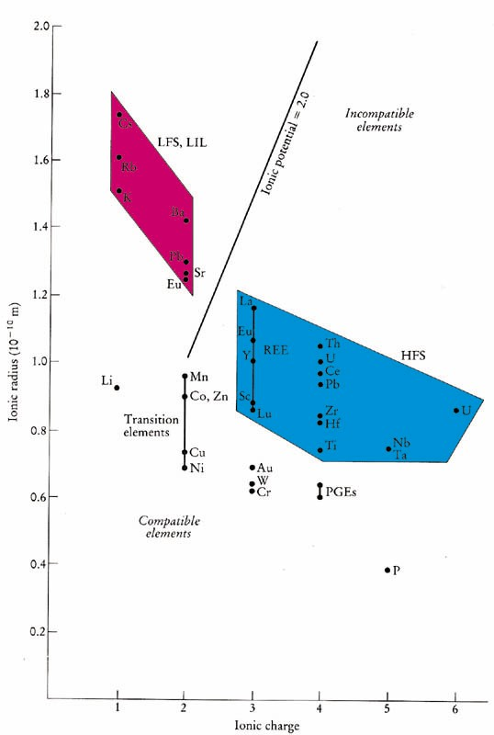
Incompatible elements commonly → two subgroups
✦ Smaller, highly charged high field strength (HFS) elements (REE, Th, U, Ce, Pb⁴⁺, Zr, Hf, Ti, Nb, Ta)
✦ Low field strength large ion lithophile (LIL) elements (K, Rb, Cs, Ba, Pb²⁺, Sr,
Eu²⁺) are more mobile, particularly if a fluid phase is involved

Slide 41
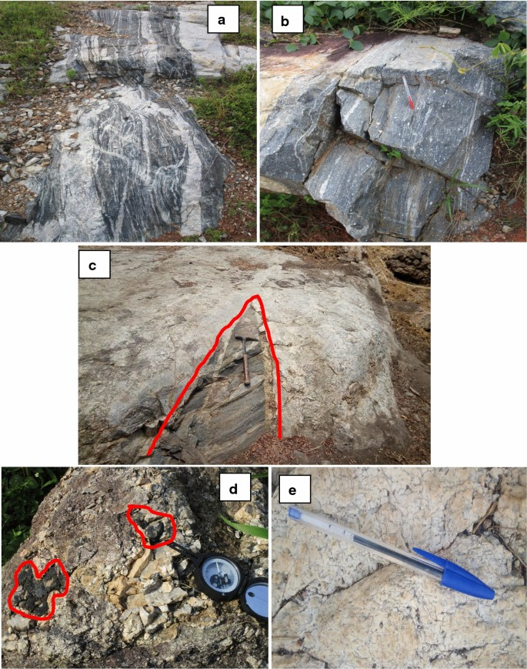
REEs in pegmatite veins
Sporadic mineralization (black tourmaline, tin, Nb–Ta) in red colour

Slide 42
Partition coefficient or Distribution coefficient - 1
It is assumed that at equilibrium, the ratio of concentration of a trace element in a solid phase (C_{s)} to its concentration in liquid (C_{L}) is a constant (D):
D= C_{s}/C_{L}
The constant is called PARTITION COEFFICIENT or DISTRIBUTION COEFFICIENT or NERNST PARTITION COEFFICIENT.
It is also denoted as K_{D}
Source: Faure, Chapter-8

Slide 43
Partition coefficient or Distribution coefficient - 2
If K_{D} = 1, then trace element is equally distributed between mineral and melt
If K_{D} = > 1, then trace element has a ‘preference’ for mineral phase & in the mineral-melt system under investigation and is a compatible trace element.
If K_{D} = < 1, then trace element has a ‘preference’ for melt phase & in the mineral-melt system under investigation and is a incompatible trace element.

Slide 44
BULK PARTITION COEFFICIENT
A rock is an aggregate of minerals, so the Bulk distribution coefficient for a rock for a specific element can be calculated from partition coefficients of constituent minerals weighed according to their proportion. It is defined by expression
D_{i} = x₁ K_{d1} + X₂K_{d2} + X₃K _{d3}…
D_{i} = bulk partition coefficient for element I
X₁ = modal proportion of mineral 1 etc
K_{d1} = parition coefficient for element i in mineral1
For eg. In a rock containing 50% olivine, 30% Opx & 20% cpx, the bulk partition coefficient would be
D_{i} = 0.5 K^{ol}_{d1} + 0.3K^{opx}_{d2} + 0.2K^{cpx} _{d3}…

Slide 45
Table 9-1. Partition Coefficients (CS /C L) for Some Commonly Used Trace Elements in Basaltic and Andesitic Rocks
 |  |  |  | Olivine Opx | Cpx | Garnet | Plag | Amph Magnetite
 | Rb |  |  | 0.010 0.022 0.014 0.040 0.010 0.013 14 5 0.70 10 0.007 0.03 0.006 0.02 0.006 0.03 0.007 0.05 0.007 0.05 0.013 0.15 | 0.031 0.060 0.026 7 34 0.056 0.092 0.230 0.445 0.474 0.582 | 0.042 0.012 0.023 0.955 1.345 0.001 0.007 0.026 0.102 0.243 1.940 | 0.071 1.830 0.23 0.01 0.01 0.148 0.082 0.055 0.039 1.5 0.023 | 0.29 0.46 0.42 6.8 29 2.00 7.4 0.544 2 0.843 2 1.340 2 1.804 1 1.557 1 2.024 1
 | Sr
 | Ba
 | Ni
 | Cr
 | La |  | Earth Elements
 | Ce
 | Nd
 | Sm
 | Eu
 | Dy
 | Er |  |  | 0.026 0.23 0.583 4.700 0.020 1.740 1.5
 | Yb |  | R | 0.049 0.34 | 0.542 | 6.167 | 0.023 | 1.642 1.4
 | Lu |  |  | 0.045 0.42 | 0.506 | 6.950 | 0.019 | 1.563
 | Data from Rollinson (1993). |  |  |  |  |  | * Eu³⁺/Eu²⁺ | Italics are estimated
are
Example: hypothetical garnet lherzolite = 60% olivine, 25% orthopyroxene, 10% clinopyroxene, and 5% garnet (all by weight), using the data in Table 9.1, is:
D_{Er} = (0.6 · 0.026) + (0.25 · 0.23) + (0.10 · 0.583) + (0.05 · 4.7) = 0.366

Slide 46
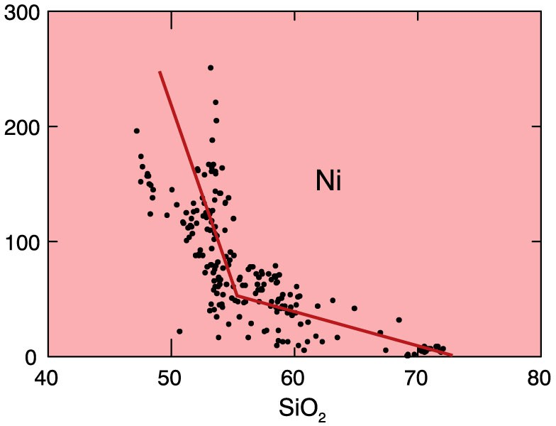
Trace elements strongly partitioned into a single mineral
Figure 9.1a. Ni Harker Diagram for Crater Lake. From data compiled by Rick Conrey. From Winter (2001) An Introduction to Igneous and Metamorphic Petrology. Prentice Hall.

